Slide 1

eclipse: effective, efficient – and easy to use?
Mona Haux, itemis AG

Slide 2
Agenda
Usability – What is it?
Usability – Why is it important?
eclipse – What about its usability?
Summary

Slide 3
What is Usability?
Usability is the extent to which a product can be used by specified users to achieve specified goals with effectiveness, efficiency and satisfaction in a specified context of use.
(ISO 9241-11)
Notes:
effectiveness: the accuracy and completeness with which specified users can achieve specified goals in particular environments efficiency: the resources expended in relation to the accuracy and completeness of goals achieved satisfaction: the comfort and acceptability of the work system to its users and other people affected by its use

Slide 4
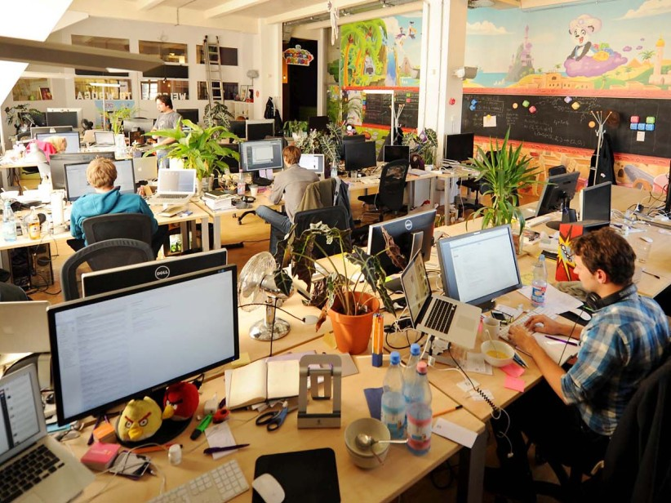
Usability is about... the user!
http://www.bz-berlin.de/multimedia/archive/00389/wooga2_38910628.jpg

Slide 5
Usability is about... the user‘s tasks!
http://www.bz-berlin.de/multimedia/archive/00389/wooga2_38910628.jpg

Slide 6
Usability is about... the user‘s working tools!
http://www.bz-berlin.de/multimedia/archive/00389/wooga2_38910628.jpg

Slide 7
Usability is about... the user‘s environment!
http://www.bz-berlin.de/multimedia/archive/00389/wooga2_38910628.jpg
Notes:
Physical
Social
Organizational

Slide 8
The 7 dialogue principles
used as criteria for measuring usability
help when trying to design for good usability

Slide 9

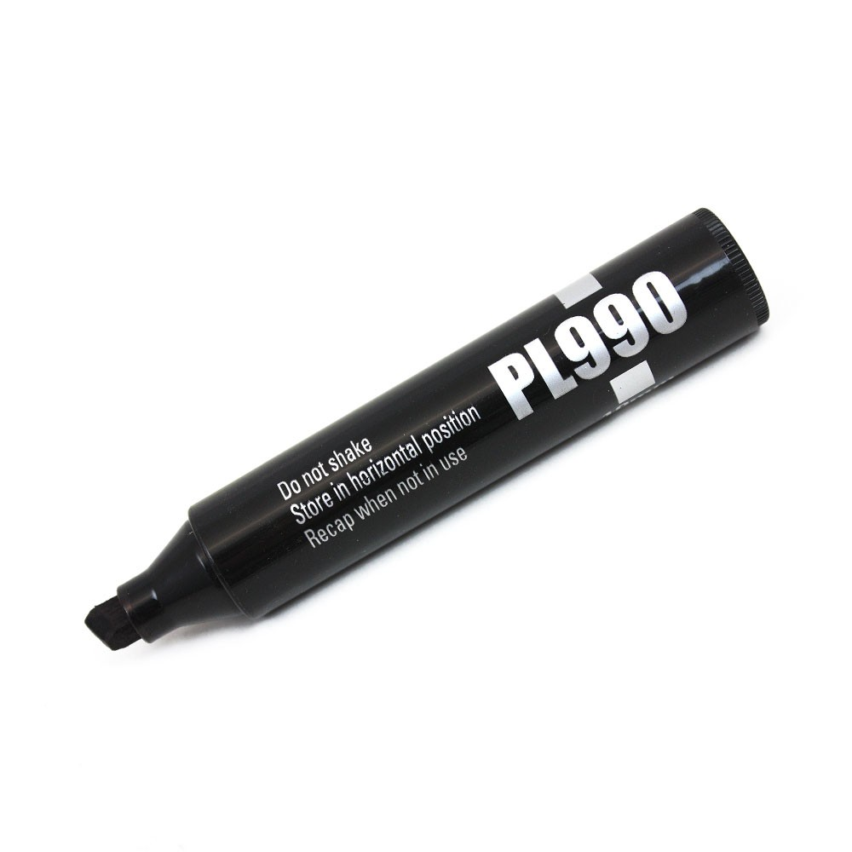
The 7 dialogue principles: Suitability for the task
http://kugelbunt-shop.de/images/product_images/original_images/2123.jpg;, http://www.tradersupplies.co.uk/media/catalog/product/cache/1/image/9df78eab33525d08d6e5fb8d27136e95/b/u/budget_marker_pen_10mm_lidoff.jpg
Notes:
Suitability for the task – the system should support the user in efficiently working on and achieving his tasks

Slide 10

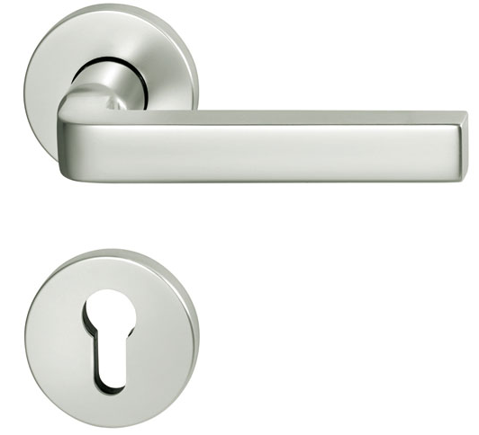
The 7 dialogue principles: Self-descriptiveness
http://smm2.de/product/produugle/20135.JPG
http://static1.schoener-wohnen.de/thumbnails/galleryImage/0001/00000000001/44/81/44810_sw201012158_fsb-chipperfiel.jpg
Notes:
Self-descriptiveness – the user can immediately see where in the system he is, which actions he can perform and how this might be done

Slide 11


The 7 dialogue principles: Controllability
http://www.ballonteam-sauerland.de/images/D-OFJH-1.jpg; http://www.taleu.at/images/header/service/anreise-flugzeug.jpg
Notes:
Controllability – the user can start and stop the activities of the system and control the sequence and the direction of the actions

Slide 12
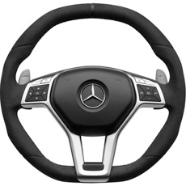
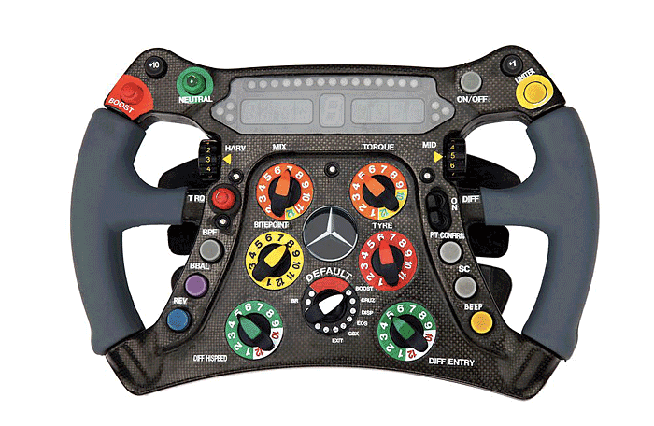
The 7 dialogue principles: Conformity with user expectations
http://www.ergosign.de/files/pages/blog/611/formel1.png http://goo.gl/cSXq9h
Notes:
Conformity with user expectations – the system is consistent within itself and with the expectations the user has

Slide 13

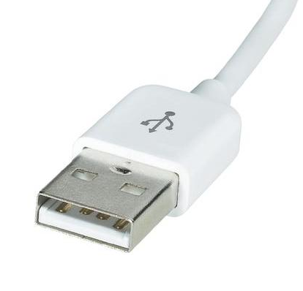
The 7 dialogue principles: Error tolerance
http://www.macnotes.de/images/lightning_connector.jpg
http://www.conrad.de/medias/global/ce/9000_9999/9700/9740/9749/974945_BB_00_FB.EPS_1000.jpg
Notes:
Error tolerance – the system prevents errors and allows to achieve the wished result with minimal effort if errors occur

Slide 14
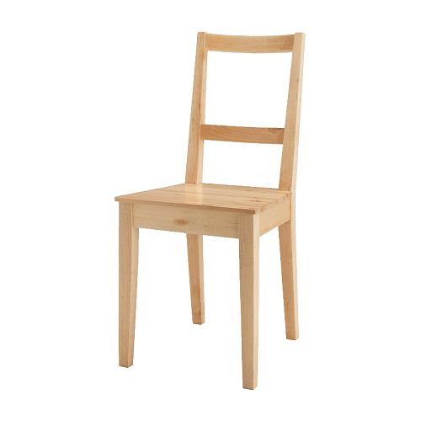
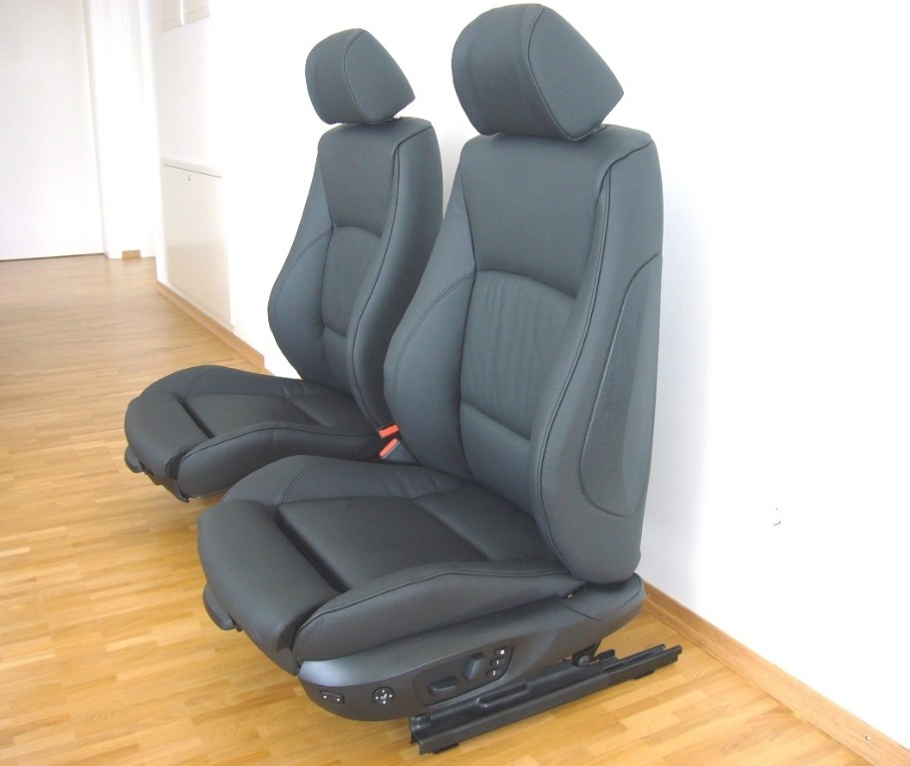
The 7 dialogue principles: Suitability for individualization
http://www.fast-alles.net/pictures/4VfR5aKwbWkP.JPG;, http://www.ikea.com/de/de/images/products/bertil-stuhl__43017_PE138396_S4.JPG
Notes:
Suitability for individualization – the user can adapt the system to match his individual capabilities and needs

Slide 15
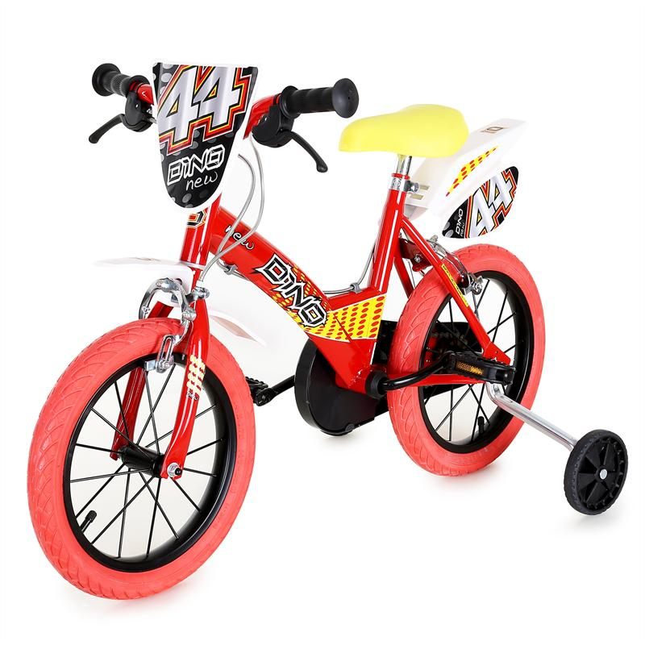
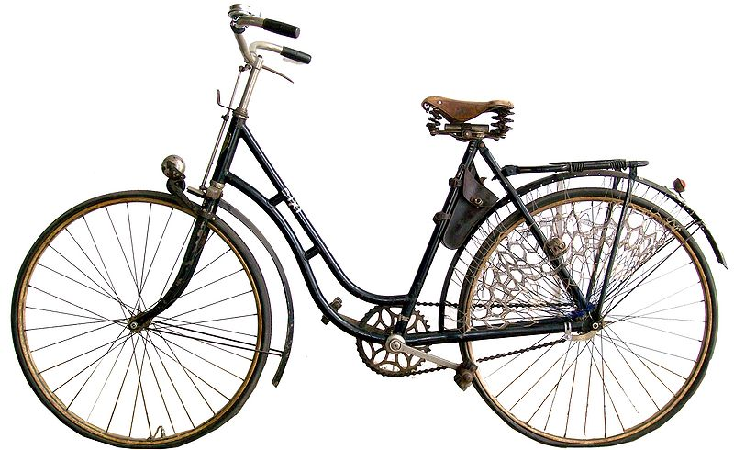
The 7 dialogue principles: Suitability for learning
http://media.elektronik-star.de/images/XL/10008434_title2_dino_14zoll_kinderfahrrad.jpg; http://wiki.w311.info/images/thumb/d/d2/Dixi-Fahrrad_Freigestellt.jpg/800px-Dixi-Fahrrad_Freigestellt.jpg
Notes:
Suitability for learning – the system supports and guides the user in learning to use the system

Slide 16

Why should I care about usability?
https://www.transparo.de/blog/wp-content/uploads/2011/04/Frau_jung_fragend.jpg

Slide 17

Why should I care about usability?
http://blog.tensator.com/uk/image.axd?picture=2012%2f7%2fiStock_000011031649Medium.jpg
Notes:
One might think: Usability Engineering takes some additional time during development?
But:
It saves time during development and during usage
The average time users spend coping with errors is 5,1hours per week

Slide 18
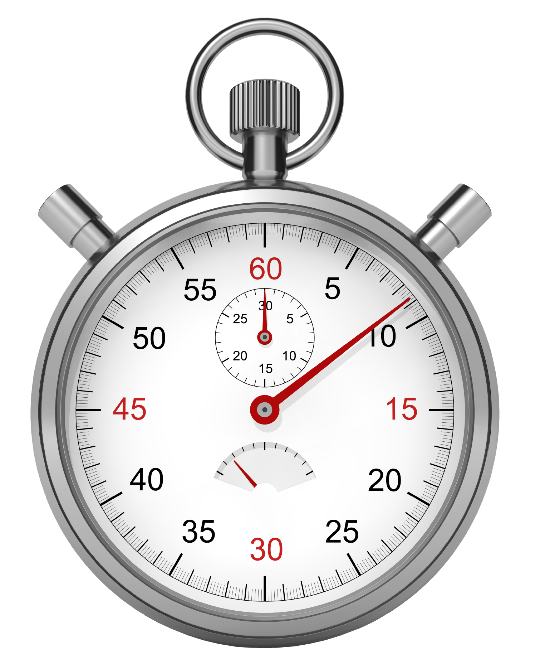
Why should I care about usability?
It saves time!
http://www.softwareag.com/blog/reality_check/wp-content/uploads/2013/06/Stopwatch_02.png
Notes:
It saves time
During development and during usage: The average time users spend coping with errors is 5,1hours per week – this can be avoided through good usability

Slide 19
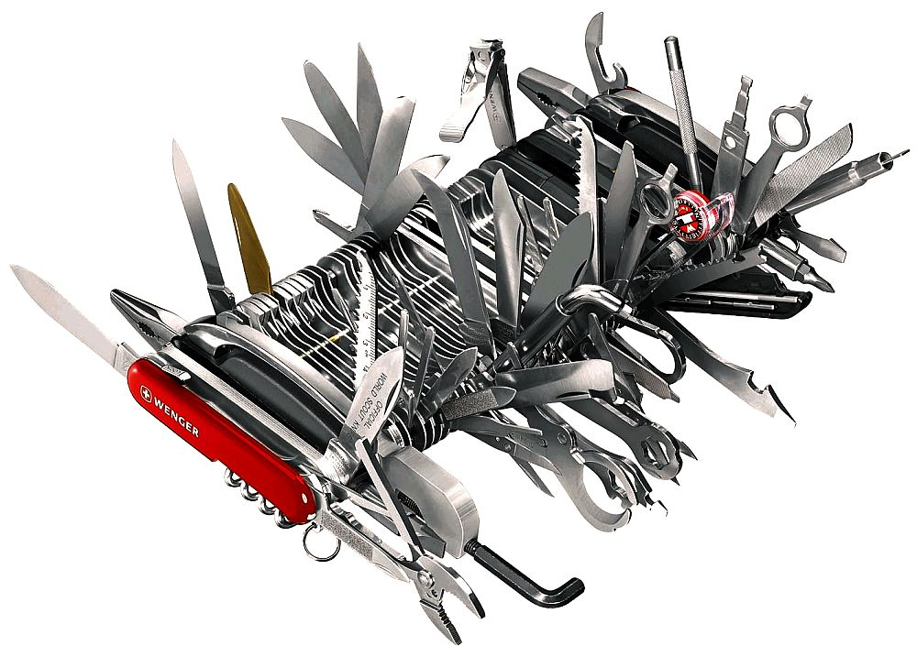
Why should I care about usability?
http://images.fxcuisine.com/blogimages/swiss-cuisine/wenger/knife-4-1000.jpg
Notes:
Without usability engineering and listening to the user one might end up implementing as much functionality as possible...

Slide 20

Why should I care about usability?
It ensures the right features are provided!
http://www.georgjensen.com/media/catalog/product/cache/10/image/9df78eab33525d08d6e5fb8d27136e95/3/3/3340015_Copenhagen_Dinner_Knife.png
Notes:
Usability Engineering leads to implementing exactly the right features – no more and no less
Therefore the user is provided with the functionality needed and can achieve his goals effectively and efficiently. That means…

Slide 21

Why should I care about usability?
http://www.geld-magazin.info/sites/all/files/kreditkarte-geld-ausgeben.jpg
Notes:
Usability Engineerin is additional effort in development projects
But: Every 1 Euro spent early in development saves 10 Euros for correction of errors during development and 100 Euros for troubleshooting after system release

Slide 22

Why should I care about usability?
It saves money!
http://okpolicy.org/wp-content/uploads/2013/01/Good-Sense-Good-Cents-Awards-Invitation-2012.bmp
Notes:
It saves time during development and usage – and time is money!
Every 1 Euro spent early in development saves 10 Euros for correction of errors during development and 100 Euros for troubleshooting after system release

Slide 23

Why should I care about usability?
http://www.salutejournal.it/wp-content/uploads/2014/02/Stress.png
Notes:
Bad usability is a real problem: it causes stress and additional effort

Slide 24

Why should I care about usability?
It reduces stress!
http://www.warrenphotographic.co.uk/photography/cats/10930.jpg
Notes:
Good usability in a product reduces stress and effort - for the user (and ideally also concerning the product development as usability engineering supports an effective and timely development process)

Slide 25

Why should I care about usability?
http://latinolinkviews.com/wp-content/uploads/2011/03/Handcuffs.jpg
Notes:
Usability in the developed product is not only nice to have; It is mandated by law. In Germany:
Arbeitsschutzgesetz (ArbSchG)
Bildschirmarbeitsverordnung (BildscharbV)

Slide 26

Why should I care about usability?
It is mandated by law!
http://goo.gl/HR3CIx
Notes:
It is mandated by law. In Germany:
Arbeitsschutzgesetz (ArbSchG)
Bildschirmarbeitsverordnung (BildscharbV)
Arbeitsschutzgesetz (ArbSchG) »Gesetz über die Durchführung von Maßnahmen des Arbeitsschutzes zur Verbesserung der Sicherheit und des Gesundheitsschutzes der Beschäftigten bei der Arbeit« Schutzziele für Beschäftigte http://www.gesetze-im-internet.de/arbschg/
Bildschirmarbeitsverordnung (BildscharbV) »Verordnung über Sicherheit und Gesundheitsschutz bei der Arbeit an Bildschirmgeräten« Umsetzung der Schutzziele des ArbSchG für Informationstechnik

Slide 27
Usability has many advantages
It ensures the right features are provided!
It saves time!
It reduces stress!
It saves money!
It is mandated by law!

Slide 28
Ok, usability sounds like a plan.
And now?

Slide 29

So, let‘s look at....

Slide 30

We use YAKINDU Traceability for examples
YAKINDU Traceability
is an eclipse-based tool
supports users in achieving traceability
is used by people who do not usually use eclipse
Notes:
(Software traceability needs to be achieved in order to fulfil certain standards and make it easier to keep an overview in big software development projects.)

Slide 31
Eclipse usability
YAKINDU Traceability users are not usually using eclipse.
The usage should be as easy as possible – usability is key
This is true for all people using eclipse – even for those who “got used” to it!

Slide 32
Let‘s start taking a look at eclipse usability

Slide 33
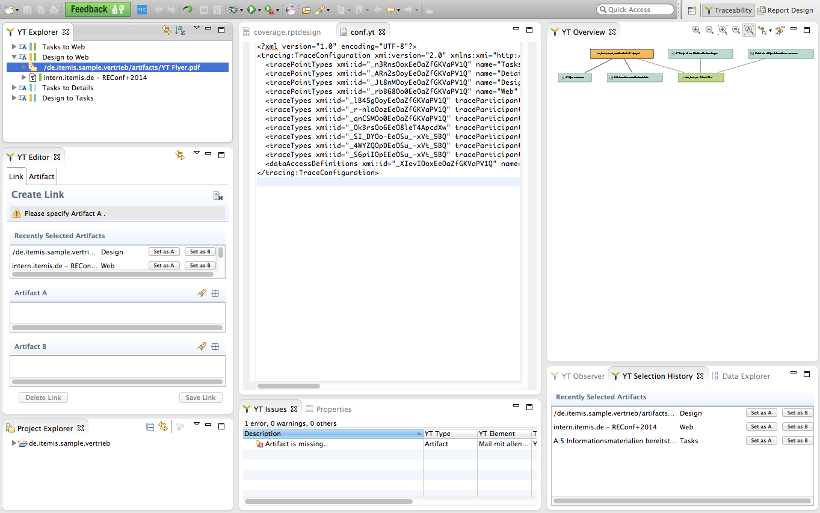
Many different views can be displayed at once
Notes:
This might be positive or negative
Many views > complexity
But: allow users to work on different tasks in parallel

Slide 34
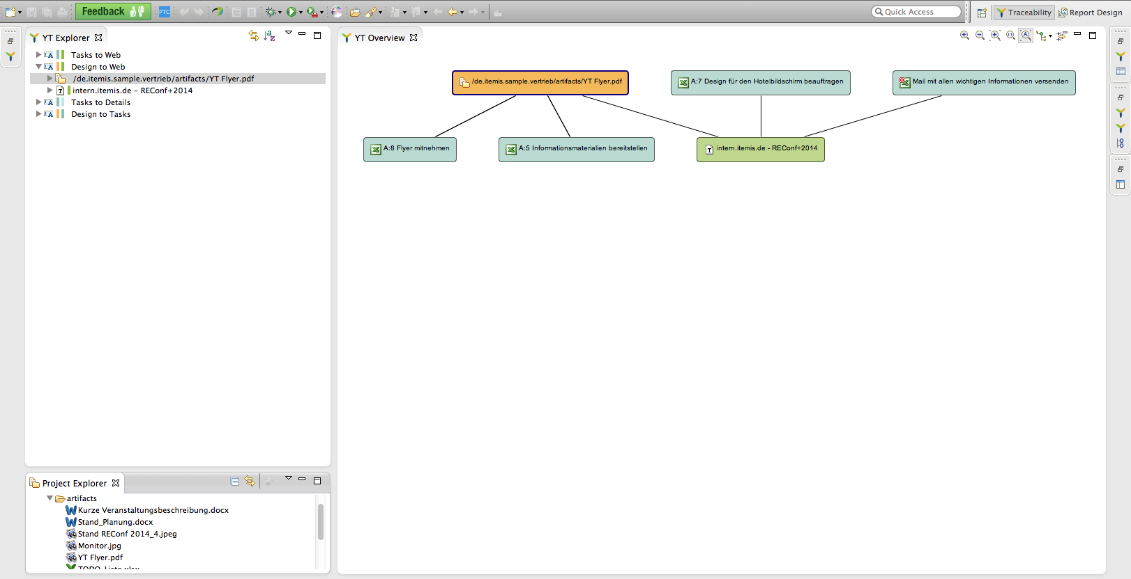
Views can be displayed and combined
Notes:
The views can be placed and combined as the user pleases> high degree of individualization + they support the user in working on different tasks in parallel (Suitability for individualization, Suitability for the task)
BUT: The views are used in an unknown, unforeseeable context – they must be clearly named and self-descriptive > fully usable as they are
It needs to be clear what can be done in a view and which options it provides… and this leads us to the next problem:…

Slide 35
Many options – but some are hard to find
Notes:
In every view there are options shown directly in the view and options hidden behind menus in the views
This violates the dialogue principle self-descriptiveness – as the user can not immediately see which options are available
It might be helpful to provide new/inexperienced users with a guided tour or tutorials in order to inform them about the other available options
Important options should be available right in the view menu – this should be made sure

Slide 36
Many options – some are easy to find
Notes:
Important options should be available and visible right in the menu of the view – this should be made sure
It might be helpful to provide new/inexperienced users with a guided tour or tutorials in order to inform them about the other available options

Slide 37
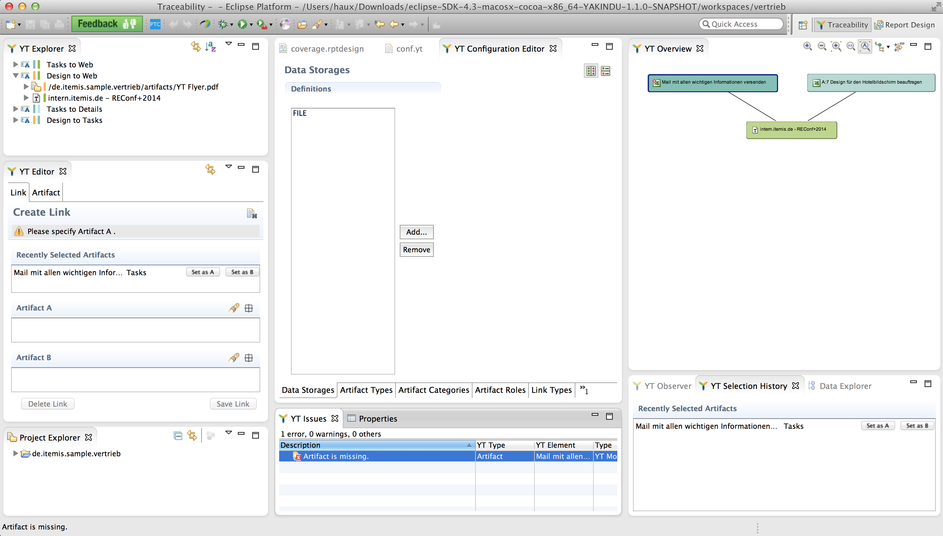
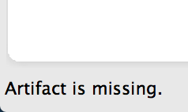
Error and status notifications are out of context
Notes:
Error and status notifications are shown in the bottom bar -> this is not conform with the users expectations, as the user does not easily find the error messages
it also violates the dialog principle self-descriptiveness

Slide 38
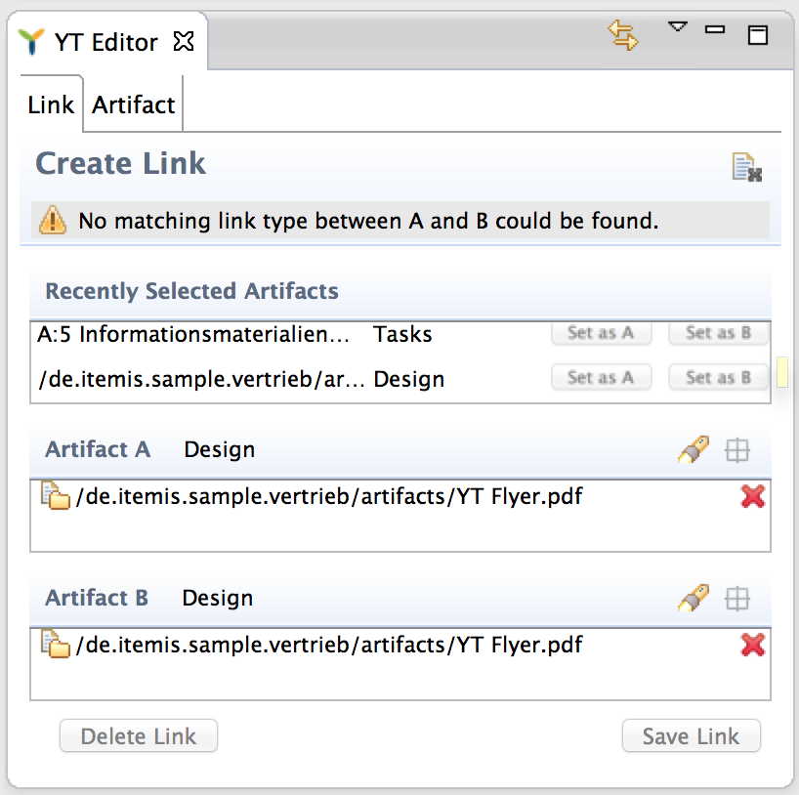
Error and status notifications should be in context
Notes:
The error and status notifications should be shown in context – in the place they relate to
This allows the user to easily notice the message and properly understand it

Slide 39
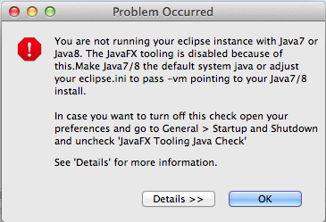
Detailed error Information is not helpful
Notes:
When starting up eclipse, you might be provided with this error message.
If you need further details, you might click on the „Detail“ Button

Slide 40
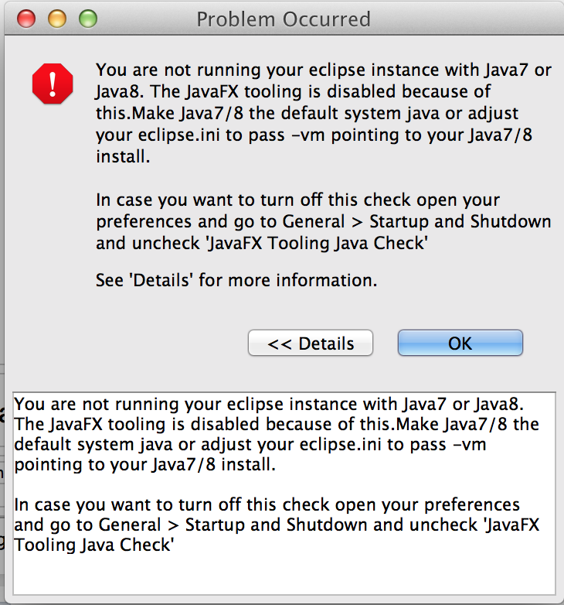
Detailed error Information is not helpful
Notes:
Exact same text in the „Details“ section as in the regular pop-up text > clicking the „Details“ Button has no additional value
No real error tolerance > The reason for the error is named -> But no detailed information on how to fix the error is provided
Instead the user is told how he can avoid the message being shown (not suitable for the tasks – this is not what the user wants to do right now) + there is no simple way to do this

Slide 41
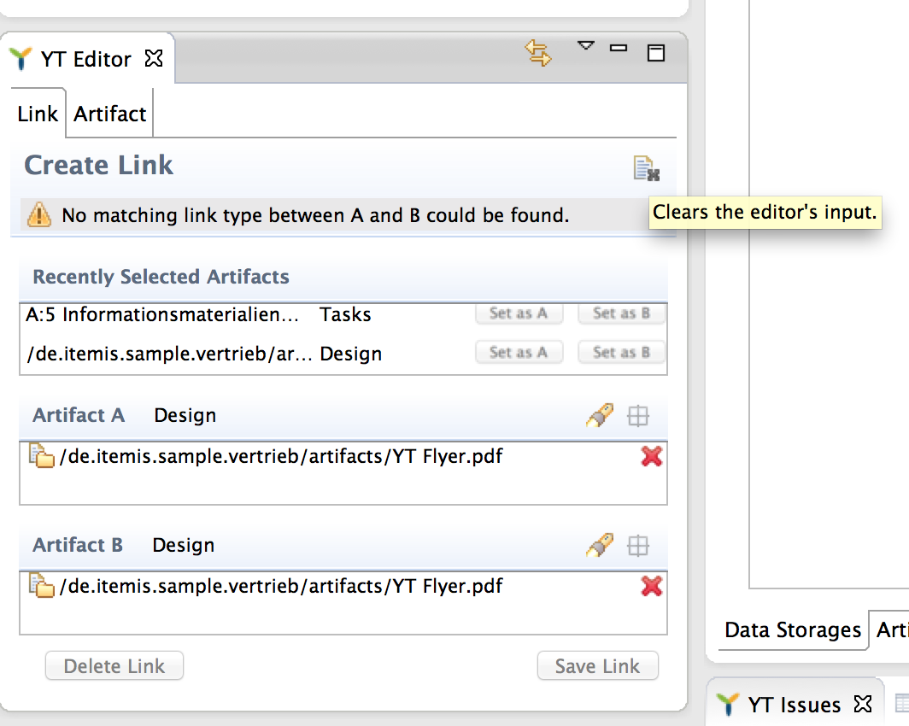
Tooltips appear way to late
Notes:
An inexperienced user might not know what all the icons stand for > the tooltips describing the functionality of an icon appear quite late
This causes no optimal self-descriptiveness, no optimal suitability for learning
Users in interviews „Oh, there are tooltips?“
Tooltips should simply appear faster! – and the icons should be designed clearly so that tooltips are not even needed

Slide 42
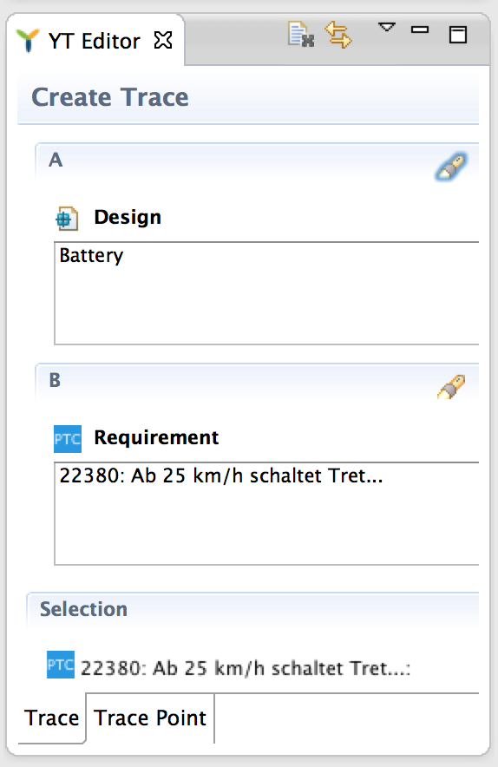
Unexpectedly tabs are found at the bottom
Notes:
Not consistent with user expectations – in almost every other program the user might know the tabs are placed at the top – if the user is not used to eclipse
This is a problem for new users – it might not be a problem for experienced eclipse users as they are used to it

Slide 43
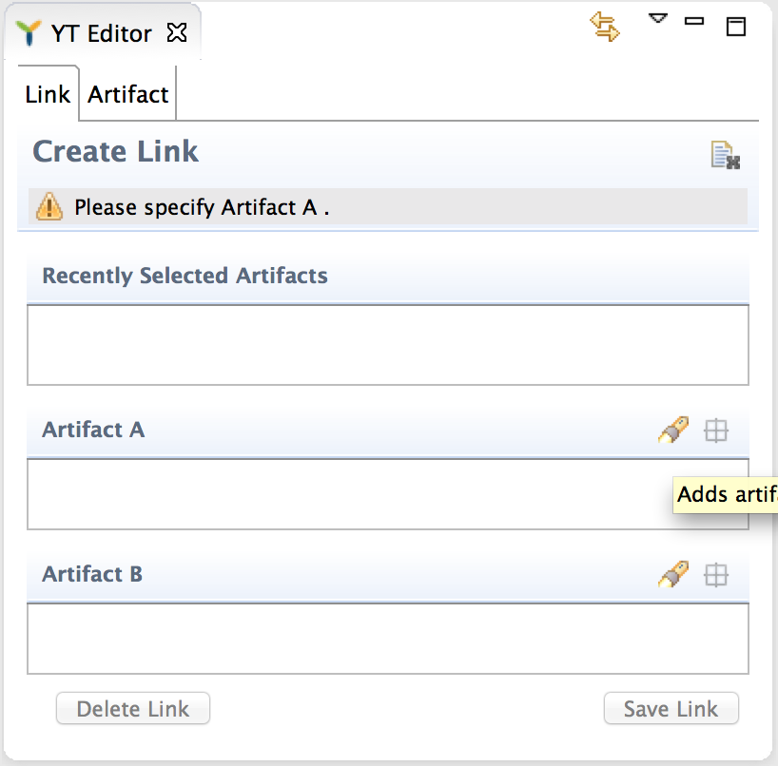
Tabs should be found at the top
Notes:
In our tool YAKINDU Traceability we put the tabs at the top as most users are not familiar with eclipse
Tabs at the top are more familiar to them + allow them to easily use the tool
Of cause this is limited: If different levels of tabs are needed this becomes hard to overview (nested tabs)

Slide 44
Summary: eclipse usability
Many different functions and options:
Complexity vs. great functional power
Many different perspectives and views:
Complexity vs. great potential for customization
eclipse has many different users with different tasks in different environments – individual solutions might be needed in some cases
Notes:
We cannot say that the usability of eclipse is bad or good – because this always depends on the user, his tasks and his environment.
But we can state that eclipse poses some hurdles – especially for new users But:
Eclipse offers a lot of functionality in different views: It is a powerful tool and hard to grasp at once – but it is also highly suitable for individualization – and this can help to get the full benefit out of using eclipse.
But there are also some general usability problems like e.g. with the status and error notifications and messages and the error dialogues that could be improved directly within eclipse.
Usability can be the factor differentiating Tools build on eclipse like YT but it can also be the factor differentiating IDEs and therefore it can be the factor deciding which IDE is used
Software development is a complex task as it is – developers do not need further distraction.
Good usability of their IDE allows them to fully focus on their tasks – and can ease their work a little bit.

Slide 45
Summary: Better eclipse usability would...
...ease the eclipse usage – especially for new users
...make working more efficient and satisfactory – even for experienced users
Notes:
Important: Experienced users are annoyed by bad usability – but they have already learned to cope with it and use the tool nonetheless
New and inexperienced users might face insuperable challenges due to bad usability and completely quit using the tool – eclipse needs to be more suitable for learnability
Usability is important and helpful – even and especially in eclipse. So, we should work on improving the eclipse usability!

Slide 46
Thank you for your attention!
Any Questions?

